Slide 1
دورة إدارة وتصنيف المجلات-المستوى الاول برعاية جامعة كويا والشبكة السويدية العراقية وريكة لتصنيف وإدارة المجلات 30-3-2020
اعداد
الدكتور عزيز إبراهيم عبدالله

Slide 2
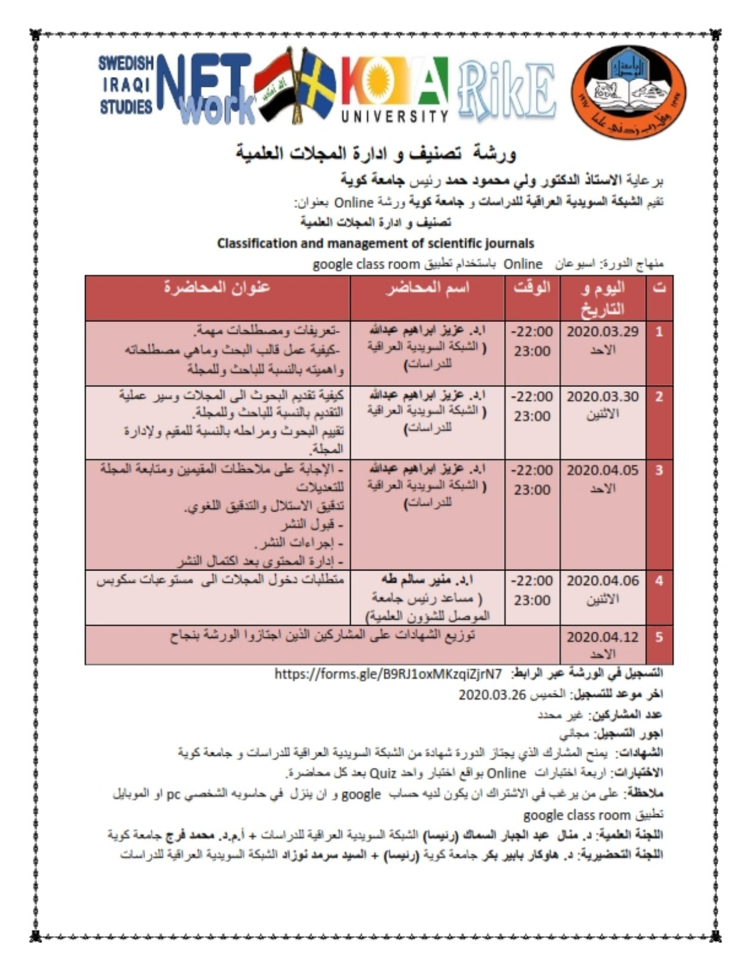

Slide 3
شكر وتقدير للجهات الراعية للدورة -جامعة كويا -الشبكة السويدية العراقية -قاعدة بيانات ريكة العالمية RIKE لادارة وتصنيف المجلات

Slide 4
دورة إدارة وتصنيف المجلات-المستوى الاول المحاضرة الاولى 30-3-2020 عملية تقديم البحث للمجلات العلمية
اعداد
الدكتور عزيز إبراهيم عبدالله

Slide 5
يرجى ملاحظة ان هناك ملف صوتي خارج هذا الملف يمكنكم الاستماع اليه حيث يشرح صفحات هذا العرض

Slide 6
http://tj-es.com/submitarticle/ نموذج لتقديم بحث الكترونيا

Slide 7
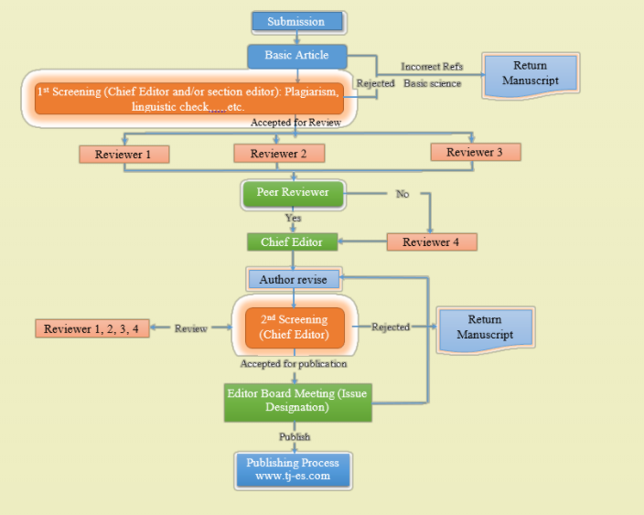

Slide 8
Checklist 1 The submission has not been previously published, nor is it before another journal for consideration (or an explanation has been provided in Comments to the Editor). 2 The submission file is in Open Office, Microsoft Word, RTF, or Word Perfect document file format. 3 Where available, URLs for the references have been provided. Preferred to use EndNote program 4 The text is 1.5 spaced; uses a 12-point font A4 papers; employs italics, rather than underlining (except with URL addresses); and all illustrations, figures, and tables are placed within the text at the appropriate points, rather than at the end. 5 The text adheres to the stylistic and bibliographic requirements outlined in the Author Guidelines. 6 If submitting to a peer-reviewed section of the journal, the instructions in Ensuring a Blind Review have been followed. 7 I read Author Guidline 8 The article writing according to TJES template ( can download it from her http://tj-es.com/wp-content/uploads/template/TJESTemplate.docx) يجب ان يكون البحث مطبوعا وفق ملف فورمات المجلة الذي يمكن تحميله من الرابط اعلاه بخلافه سوف يتم اهمال البحث

Slide 9
Corresponding Author Information Title: Prof, Dr. …….etc Author Full name Affiliations E-mail Alternative E-mail Phon Number with Country Code Manuscript Information Type of Submission New Submission تقديم جديد First Editor Revisions اجراء تعديلات المحرر للمرة الاولى Second Editor Revisions اجراء تعديلات المحرر للمرة الثانية First Reviewers Revisions اجراء تعديلات المقومين للمرة الاولى Second Reviewers Revisions اجراء تعديلات المقومين للمرة الثانية Publishing Revisions one ملاحظات الناشر الاولى Publishing Revisions two ملاحظات الناشر الثانية other Co-Authors if any? (must include full name with title, e-mail, affiliation) Manuscript Title Manuscript specialization in general Upload Manuscript (DOC or DOCX ) Choose a file

Slide 10
Editorial board -First Screen -Similarity rate -Send to reviewer

Slide 11
Review Form http://www.tj-es.com/tjesreviewform Step 1 Reviewer information Title Reviewer Full name Affiliations E-mail Alternative E-mail Phon Number with Country Code Research interests Manuscript Information Manuscript Title Manuscript Code NEXT STEP

Slide 12
Review Form http://www.tj-es.com/tjesreviewform Step 2 Review Form Please select a number to indicate your level of agreement with the following questions. Select the lowest value (1) to indicate that you disagree entirely, or the highest value (5) to indicate that you agree completely. The Manuscript is within the scope of TJES journal 1 2 3 4 5 The Manuscript title reflects the content and purpose of the research. 1 2 3 4 5 Your comments about Manuscript title The abstract includes information important for understanding the content of the Manuscript. 1 2 3 4 5 Your comments about abstract The introduction clearly defines the purpose and objective of the work 1 2 3 4 5 Your comments about the introduction A review of previous researches are good and up to date 1 2 3 4 5 Your comments about review of previous researches

Slide 13
The results and discussions are adequate 1 2 3 4 5 your comments about results and discussions The conclusions is based and contributes to the discharge of treated problems 1 2 3 4 5 Your comments about conclusions The references reflect the topicality of the article, and up to date 1 2 3 4 5 your comments about references The Manuscript is free of technical errors 1 2 3 4 5 The Manuscript is clearly readable 1 2 3 4 5 Your comments about 1-The Manuscript is clearly readable and 2-The Manuscript is free of technical errors

Slide 14
1 2 3 4 5 your comments about results and discussions The conclusions is based and contributes to the discharge of treated problems 1 2 3 4 5 Your comments about conclusions The references reflect the topicality of the article, and up to date 1 2 3 4 5 your comments about references The Manuscript is free of technical errors 1 2 3 4 5 The Manuscript is clearly readable 1 2 3 4 5 Your comments about 1-The Manuscript is clearly readable and 2-The Manuscript is free of technical errors The figures are clear & do clearly convey the intended message. 1 2 3 4 5 Please evaluate the number of figures that accompany this manuscript Figures and text are well-balanced and complementary insufficient to illustrate concepts Not all data is represented graphically that should be Some illustration are redundant figures are not needed for this subject matter included figures are irrelevant to the subject matter The Tables are clear & do clearly convey the intended message. 1 2 3 4 5

Slide 15
Decision -Reject -Accept with major correction -Accept with minor correction

Slide 16
شكرا لحسن اصغائكم

